Slide 1
Cache
Compiled by:
Sarosh shahid

Slide 2
Cache Miss
00 | 47
01 | 25
02 | 5
03 | 6
04 | 88
05 | 99
06 | 21
07 | 58
08 | 57
09 | 98
0A | 65
0B | 22
MOV AL, [08]
Find data in cache
Find data in memory
Not Found
Place 57 in
cache
57
57
Processor
Cache
CACHE MISS
Memory

Slide 3
Cache Hit
00 | 47
01 | 25
02 | 5
03 | 6
04 | 88
05 | 99
06 | 21
07 | 58
08 | 57
09 | 98
0A | 65
0B | 22
MOV AL, [08]
Find data in cache
Found
Data 57 in
cache
57
Processor
Cache
CACHE HIT
Memory

Slide 4
Cache Miss
00 | 47
01 | 25
02 | 5
03 | 6
04 | 88
05 | 99
06 | 21
07 | 58
08 | 57
09 | 98
0A | 65
0B | 22
Find data in
L1 cache
Find data in
L2 cache
Find data in
memory
MOV AL, [08]
Not Found
Not Found
57
Place 57 in
L1 cache
Place 57 in
L2 cache
57
57
Processor
L1 Cache
L2 Cache
L1 CACHE MISS
L2 CACHE MISS
Memory

Slide 5
Cache Miss
00 | 47
01 | 25
02 | 5
03 | 6
04 | 88
05 | 99
06 | 21
07 | 58
08 | 57
09 | 98
0A | 65
0B | 22
Find data in
L1 cache
Find data in
L2 cache
MOV AL, [08]
Not Found
Found
57
Place 57 in
L1 cache
Data 57 in
L2 cache
57
Processor
L1 Cache
L2 Cache
L1 CACHE MISS
L2 CACHE HIT
Memory

Slide 6
Locality
Temporal Locality:
Locality in time
If data used recently, likely to use it again soon
How to exploit: keep recently accessed data in higher levels of memory hierarchy
Spatial Locality:
Locality in space
If data used recently, likely to use nearby data soon
How to exploit: when access data, bring nearby data into higher levels of memory hierarchy too

Slide 7
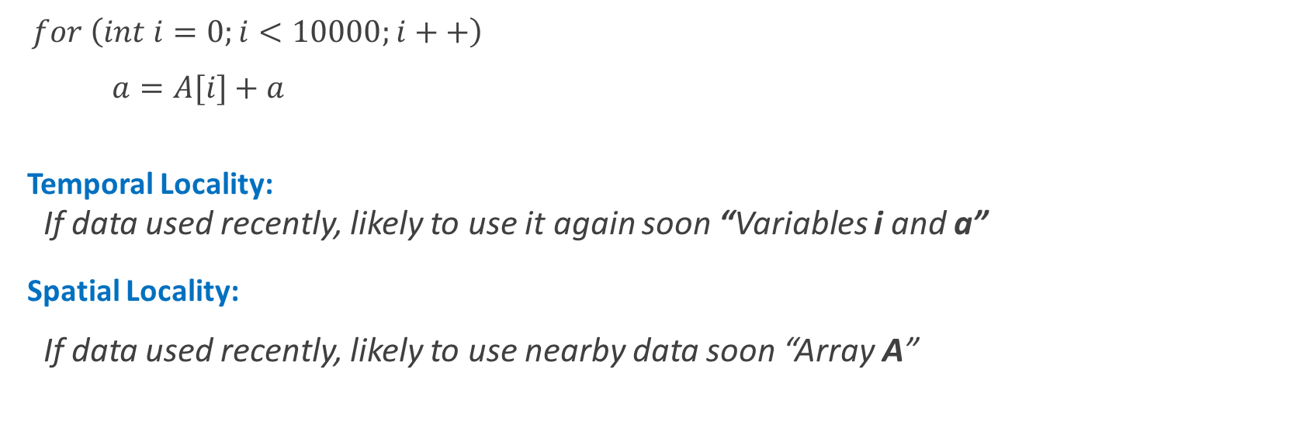
Locality
$for \left(int i=0;i<10000;i++\right)$
$a=A[i]+a$
Temporal Locality:
If data used recently, likely to use it again soon “Variables i and a”
Spatial Locality:
If data used recently, likely to use nearby data soon “Array A”

Slide 8
What data is held in cache?
Ideally, cache anticipates needed data and puts it in cache
But impossible to predict future
Use past to predict future – temporal and spatial locality:
Temporal locality: copy newly accessed data into cache
Spatial locality: copy neighboring data into cache too

Slide 9

Cache Performance Analysis
$$Miss Rate=\frac{Number of misses}{Number of total memory Accesses}=1 −Hit Rate$$
$$Hit Rate=\frac{Number of hits}{Number of total memory Accesses}=1 −Miss Rate$$

Slide 10
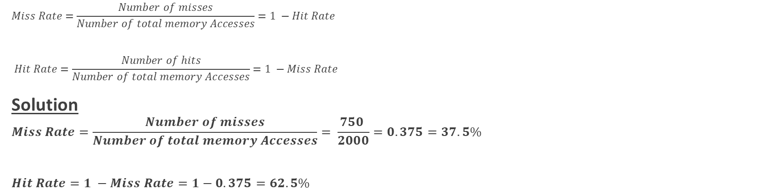
Cache Performance Analysis
Example
Suppose a program has 2000 data access instructions (load or stores), and 1250 of these requested data values are found in the cache. The other 750 data values are supplied to the processor by main memory or disk memory. What are the miss and hit rates for the cache?
$$Miss Rate=\frac{Number of misses}{Number of total memory Accesses}=1 −Hit Rate$$
$$Hit Rate=\frac{Number of hits}{Number of total memory Accesses}=1 −Miss Rate$$
Solution
$$Miss Rate=\frac{Number of misses}{Number of total memory Accesses}= \frac{750 }{2000}=0.375=37.5\%$$
$$Hit Rate=1 −Miss Rate=1−0.375=62.5\%$$

Slide 11
Cache Terminologies
Cache Capacity C = Total number of bytes that can be stored in the cache
Data is transferred between memory and cache in blocks of fixed size called cache lines or cache blocks.
b = Block size
Cache Line
Block 0
Block 1
Block 2
Block 3
Block 4
Block 5
Block 6
Block 7
Cache

Slide 12
Cache Terminologies
b = 32 bits = 4B
C = 64 bits = 8B
Cache Line
Block 0 = 4B
Block 1 = 4B
Cache

Slide 13
Block Size
Block 0 | 00 | 47
 | 01 | 25
 | 02 | 5
 | 03 | 6
Block 1 | 04 | 88
 | 05 | 99
 | 06 | 21
 | 07 | 58
Block 2 | 08 | 57
 | 09 | 98
 | 0A | 65
 | 0B | 22
Block 3 | 0C | 66
 | 0D | 8
 | 0E | 55
 | 0F | 1
b = 32 bits = 4B
C = 64 bits = 8B
Cache Line
Block 0 = 4B
Block 1 = 4B
Cache
One block of cache can hold 4Bytes so memory is also logically
divided into equal chunks of 4 bytes and all 4 bytes are brought in the cache at once.
Memory

Slide 14
Block Size
Block 0 | 00 | 47
 | 01 | 25
 | 02 | 5
 | 03 | 6
Block 1 | 04 | 88
 | 05 | 99
 | 06 | 21
 | 07 | 58
Block 2 | 08 | 57
 | 09 | 98
 | 0A | 65
 | 0B | 22
Block 3 | 0C | 66
 | 0D | 8
 | 0E | 55
 | 0F | 1
b = 32 bits = 4B
C = 64 bits = 8B
Cache Line
Block 0 = 4B | 57 | 98 | 65 | 22
Block 1 = 4B
Cache
MOV AL, [09]
Instead of bringing only [09] will bring the whole block in the cache
Block size = 4B so will bring 4Bytes and as the address [09] is in “Block 2” and it maps to the “yellow colored” block of the cache… (Spatial Locality)

Slide 15
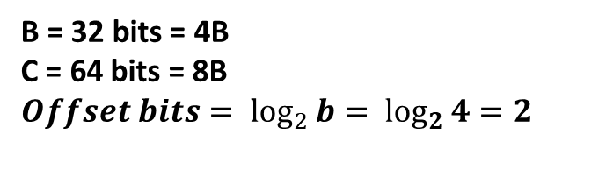
Offset Bits
Block 0 | 00 | 47
 | 01 | 25
 | 02 | 5
 | 03 | 6
Block 1 | 04 | 88
 | 05 | 99
 | 06 | 21
 | 07 | 58
Block 2 | 08 | 57
 | 09 | 98
 | 0A | 65
 | 0B | 22
Block 3 | 0C | 66
 | 0D | 8
 | 0E | 55
 | 0F | 1
B = 32 bits = 4B
C = 64 bits = 8B
$$Offset bits= \log_{2}{b= \log_{2}{4}}=2$$
Cache Line
Offset | 00 | 01 | 10 | 11
Block 0 = 4B | 57 | 98 | 65 | 22
Block 1 = 4B
Cache
MOV AL, [09]
Offset bits are used to identify the data
[09] is at offset “01b or 1”
[0A] is at offset “10b or 2” and so on

Slide 16
Cache Terminology
Capacity (C):
number of data bytes in cache
Block size (b):
bytes of data brought into cache at once
Number of blocks (B = C/b):
number of blocks in cache: B = C/b
Degree of associativity (N):
number of blocks in a set
Number of sets (S = B/N):
each memory address maps to exactly one cache set

Slide 17
Cache Types
Direct Mapped Cache
N-way Associative Cache
Fully Associative Cache
Set # 0
Set # 1
Set # 2
Set # 3
Set # 4
Set # 5
Set # 6
Set # 7
Set # 0
Set # 1
Set # 2
Set # 3
Set # 0
Set # 1
Set # 0
One-way Associative Cache
1 block per set
Two-way Associative Cache
Four-way Associative Cache
N blocks per set
All cache blocks in one set

Slide 18
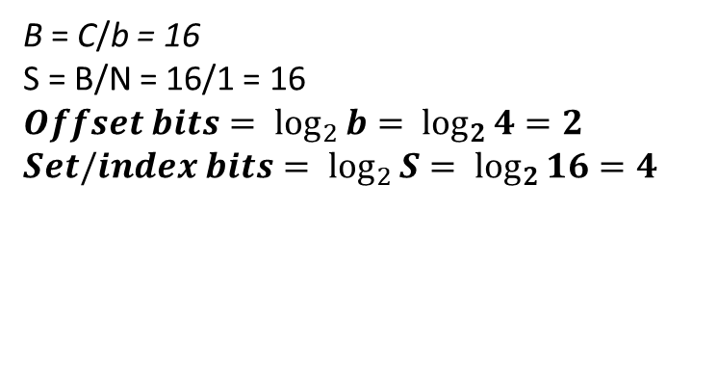
Design Cache
b = 4B
C = 64B
N = 1 (Direct Mapped)
Offset Sets | 00 | 01 | 10 | 11
0000
0001
0010
0011
0100
0101
……..
1101
1110
1111
B = C/b = 16
S = B/N = 16/1 = 16
$$Offset bits= \log_{2}{b= \log_{2}{4}}=2$$
$$Set/index bits= \log_{2}{S= \log_{2}{16}}=4$$

Slide 19
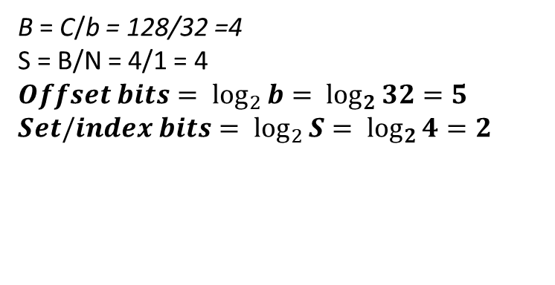
Design Cache
b = 32B
C = 128B
N = 1 (Direct Mapped)
Offset Sets | 00000 | 00001 | 00010 | ….. | 11110 | 11111
00
01
10
11
B = C/b = 128/32 =4
S = B/N = 4/1 = 4
$$Offset bits= \log_{2}{b= \log_{2}{32}}=5$$
$$Set/index bits= \log_{2}{S= \log_{2}{4}}=2$$

Slide 20
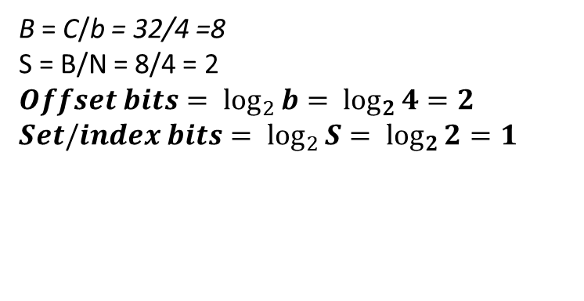
Design Cache
b = 4B
C = 32B
N = 4 (4-way associative)
Offset Sets | 00 | 01 | 10 | 11
0
1
B = C/b = 32/4 =8
S = B/N = 8/4 = 2
$$Offset bits= \log_{2}{b= \log_{2}{4}}=2$$
$$Set/index bits= \log_{2}{S= \log_{2}{2}}=1$$

Slide 21
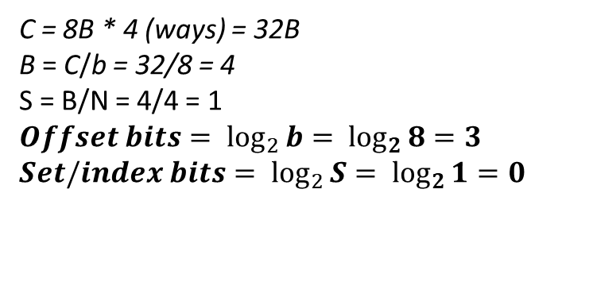
Design Cache
b = 8B
Full Associative Cache
Single set with 4-ways
Offset Sets | 000 | 001 | 010 | 011 | 100 | 101 | 110 | 111
0
C = 8B * 4 (ways) = 32B
B = C/b = 32/8 = 4
S = B/N = 4/4 = 1
$$Offset bits= \log_{2}{b= \log_{2}{8}}=3$$
$$Set/index bits= \log_{2}{S= \log_{2}{1}}=0$$

Slide 22
Cache Terminologies
Tag Bits - A unique identifier for a group of data. Because different regions of memory may be mapped into a single block, the tag is used to differentiate between them.
We need to add tags to the cache, which supply the rest of the address bits to let us distinguish between different memory locations that map to the same cache block.
Valid bit (V)- A bit of information that indicates whether the data in a block is valid (1) or not (0).
At the very start, the cache is empty and does not contain valid data.
We should account for this by adding a valid bit for each cache block.
When the system is initialized, all the valid bits are set to 0. When data is loaded into a particular cache block, the corresponding valid bit is set to 1.

Slide 23
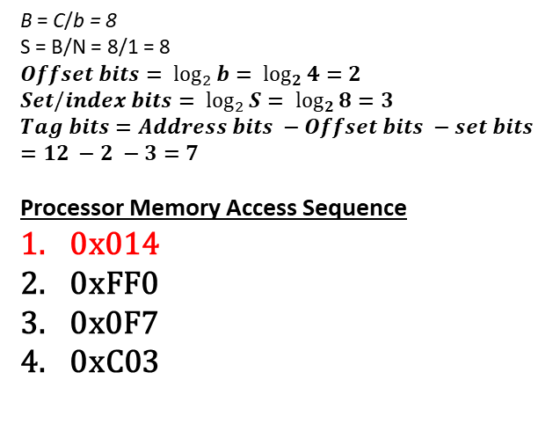
Example 01
Tag Bits Set bits Offset bits
Convert to
binary
0x014
0000 0001 0100
000 | 00000000
004 | 00000004
008 | 00000008
00C | 0000000C
010 | 00000010
014 | 00000014
018 | 00000018
01C | 0000001C
020 | 00000020
…….
FF4 | 00000FF4
FF8 | 00000FF8
FFC | 00000FFC
b = 4B
C = 32B
N = 1 (Direct Mapped)
Addresses are 12 bits
Sets | V bit | Tags | 00 | 01 | 10 | 11
000 | 0
001 | 0
010 | 0
011 | 0
100 | 0
101 | 1 | 0000000 | 00 | 00 | 00 | 14
110 | 0
111 | 0
Sets | V bit | Tags | 00 | 01 | 10 | 11
000 | 0
001 | 0
010 | 0
011 | 0
100 | 0
101 | 0
110 | 0
111 | 0
B = C/b = 8
S = B/N = 8/1 = 8
$$Offset bits= \log_{2}{b= \log_{2}{4}}=2$$
$$Set/index bits= \log_{2}{S= \log_{2}{8}}=3$$
$$Tag bits=Address bits −Offset bits −set bits=12 −2 −3=7$$
Processor Memory Access Sequence
0x014
0xFF0
0x0F7
0xC03
1
Cache
Memory
Cache Miss = 1 Cache Hit = 0

Slide 24
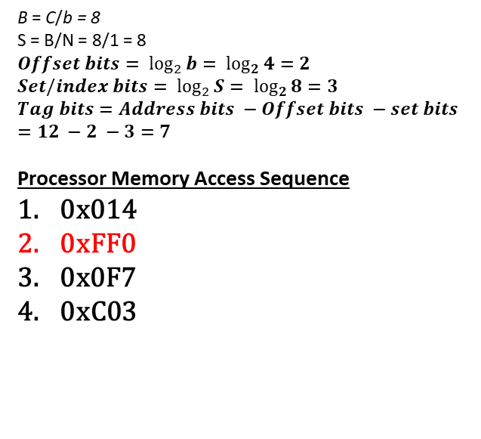
Example 01
Tag Bits Set bits Offset bits
Convert to
binary
0xFF0
1111 1111 0000
000 | 00000000
004 | 00000004
008 | 00000008
00C | 0000000C
010 | 00000010
014 | 00000014
018 | 00000018
01C | 0000001C
020 | 00000020
…….
FF4 | 00000FF4
FF8 | 00000FF8
FFC | 00000FFC
b = 4B
C = 32B
N = 1 (Direct Mapped)
Addresses are 12 bits
Sets | V bit | Tags | 00 | 01 | 10 | 11
000 | 0
001 | 0
010 | 0
011 | 0
100 | 1 | 1111111 | 00 | 00 | 0F | F0
101 | 1 | 0000000 | 00 | 00 | 00 | 14
110 | 0
111 | 0
Sets | V bit | Tags | 00 | 01 | 10 | 11
000 | 0
001 | 0
010 | 0
011 | 0
100 | 0
101 | 1 | 0000000 | 00 | 00 | 00 | 14
110 | 0
111 | 0
B = C/b = 8
S = B/N = 8/1 = 8
$$Offset bits= \log_{2}{b= \log_{2}{4}}=2$$
$$Set/index bits= \log_{2}{S= \log_{2}{8}}=3$$
$$Tag bits=Address bits −Offset bits −set bits=12 −2 −3=7$$
Processor Memory Access Sequence
0x014
0xFF0
0x0F7
0xC03
Cache
Memory
Cache Miss = 2 Cache Hit = 0

Slide 25
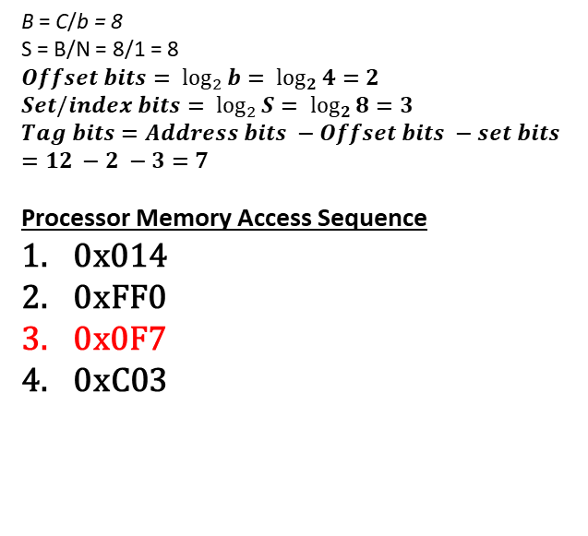
Example 01
Tag Bits Set bits Offset bits
Convert to
binary
0x0F7
0000 1111 0111
000 | 00000000
004 | 00000004
008 | 00000008
00C | 0000000C
010 | 00000010
014 | 00000014
018 | 00000018
01C | 0000001C
020 | 00000020
…….
FF4 | 00000FF4
FF8 | 00000FF8
FFC | 00000FFC
b = 4B
C = 32B
N = 1 (Direct Mapped)
Addresses are 12 bits
Sets | V bit | Tags | 00 | 01 | 10 | 11
000 | 0
001 | 0
010 | 0
011 | 0
100 | 1 | 1111111 | 00 | 00 | 0F | F0
101 | 1 | 0000000 | 00 | 00 | 00 | 14
110 | 0
111 | 0
Sets | V bit | Tags | 00 | 01 | 10 | 11
000 | 0
001 | 0
010 | 0
011 | 0
100 | 1 | 1111111 | 00 | 00 | 0F | F0
101 | 1 | 0000111 | 00 | 00 | 00 | F7
110 | 0
111 | 0
B = C/b = 8
S = B/N = 8/1 = 8
$$Offset bits= \log_{2}{b= \log_{2}{4}}=2$$
$$Set/index bits= \log_{2}{S= \log_{2}{8}}=3$$
$$Tag bits=Address bits −Offset bits −set bits=12 −2 −3=7$$
Processor Memory Access Sequence
0x014
0xFF0
0x0F7
0xC03
Cache
Memory
Data already present in the set “101”. To check whether it’s the same data we need “compare the tag bits”. As
0000000 ≠ 0000111 It means we have to replace the data.
Cache Miss = 3 Cache Hit = 0

Slide 26
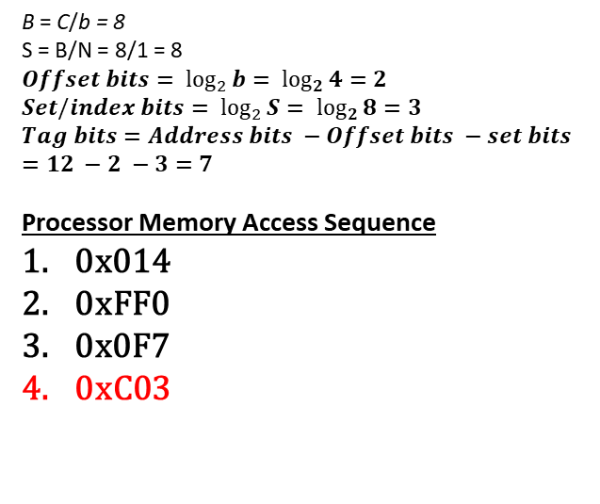
Example 01
Tag Bits Set bits Offset bits
Convert to
binary
0xC03
1100 0000 0011
000 | 00000000
004 | 00000004
008 | 00000008
00C | 0000000C
010 | 00000010
014 | 00000014
018 | 00000018
01C | 0000001C
020 | 00000020
…….
FF4 | 00000FF4
FF8 | 00000FF8
FFC | 00000FFC
b = 4B
C = 32B
N = 1 (Direct Mapped)
Addresses are 12 bits
Sets | V bit | Tags | 00 | 01 | 10 | 11
000 | 1 | 1100000 | 00 | 00 | 0C | 03
001 | 0
010 | 0
011 | 0
100 | 1 | 1111111 | 00 | 00 | 0F | F0
101 | 1 | 0000111 | 00 | 00 | 00 | F7
110 | 0
111 | 0
Sets | V bit | Tags | 00 | 01 | 10 | 11
000 | 0
001 | 0
010 | 0
011 | 0
100 | 1 | 1111111 | 00 | 00 | 0F | F0
101 | 1 | 0000111 | 00 | 00 | 00 | F7
110 | 0
111 | 0
B = C/b = 8
S = B/N = 8/1 = 8
$$Offset bits= \log_{2}{b= \log_{2}{4}}=2$$
$$Set/index bits= \log_{2}{S= \log_{2}{8}}=3$$
$$Tag bits=Address bits −Offset bits −set bits=12 −2 −3=7$$
Processor Memory Access Sequence
0x014
0xFF0
0x0F7
0xC03
Cache
Memory
Cache Miss = 4 Cache Hit = 0

Slide 27
LRU bit
Least recently used (LRU) replacement: the least recently used block in a set evicted in case of N-associative and fully associative caches.
In case of 2-way associative cache, 1-bit is required to keep check of recently used data block.
When a block is accessed its LRU bit will be set to zero (now it’s the least recently used data) and increment all the other values of LRU bit accordingly.
When data is to be evicted from a block, replace the block with maximum value of LRU bit (1 in 2-way associative, 3 in 4-way associative and so on).
Example : Set “i” of a 4-way associative cache
LRU bit | Data block
01 | D0
00 | D1
11 | D2
10 | D3
The LRU bit indicates the sequence of memory access only for this particular set was in order –
D2 D3 D0 D1
And D1 with the least LRU bit value is the most recently accessed

Slide 28
LRU bit
Least recently used (LRU) replacement: the least recently used block in a set evicted in case of N-associative and fully associative caches.
Example : Set “i” of a 4-way associative cache
LRU bit | Data block
01 | D0
00 | D1
11 | D2
10 | D3
LRU bit | Data block
10 | D0
01 | D1
11 | D2
00 | D3
After the data D3 is accessed again
Set the least recently used D3 to 0 and increment all the remaining bit accordingly

Slide 29
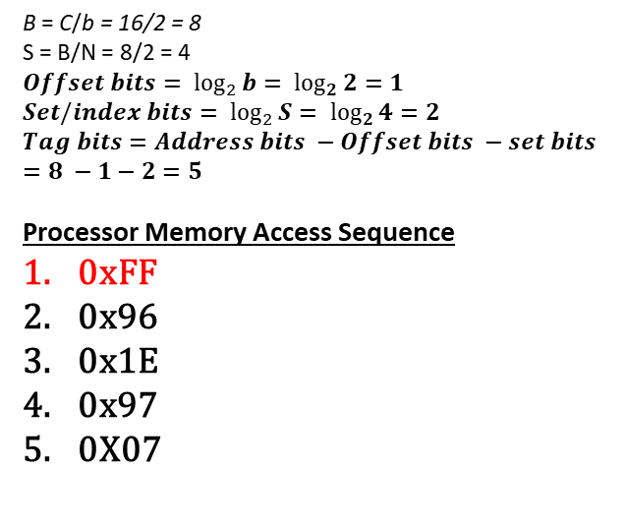
Example 02
Tag Bits Set bits Offset bits
Convert to
binary
0xFF
1111 1111
00 | 00
01 | 01
02 | 02
03 | 03
04 | 04
05 | 05
06 | 06
07 | 07
08 | 08
…….
FD | FD
FE | FE
FF | FF
b = 2B
C = 16B
N = 2 (2-way associative)
Addresses are 8 bits
Sets | V bit | LRU bit | Tags | 0 | 1
00 | 0
 | 0
01 | 0
 | 0
10 | 0
 | 0
11 | 0
 | 0
Sets | V bit | LRU bit | Tags | 0 | 1
00 | 0
 | 0
01 | 0
 | 0
10 | 0
 | 0
11 | 1 | 0 | 11111 | FE | FF
 | 0
B = C/b = 16/2 = 8
S = B/N = 8/2 = 4
$$Offset bits= \log_{2}{b= \log_{2}{2}}=1$$
$$Set/index bits= \log_{2}{S= \log_{2}{4}}=2$$
$$Tag bits=Address bits −Offset bits −set bits=8 −1−2=5$$
Processor Memory Access Sequence
0xFF
0x96
0x1E
0x97
0X07
Cache
Memory
Cache Miss = 1 Cache Hit = 0

Slide 30
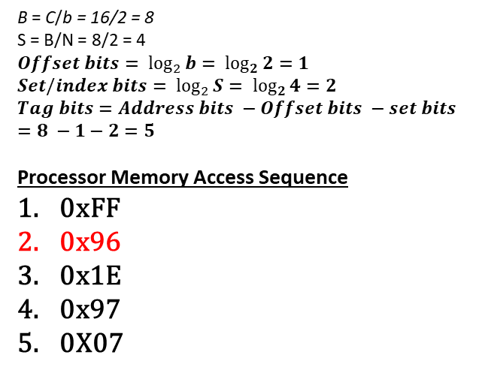
Example 02
Tag Bits Set bits Offset bits
Convert to
binary
0x96
1001 0110
00 | 00
01 | 01
02 | 02
03 | 03
04 | 04
05 | 05
06 | 06
07 | 07
08 | 08
…….
FD | FD
FE | FE
FF | FF
b = 2B
C = 16B
N = 2 (2-way associative)
Addresses are 8 bits
Sets | V bit | LRU bit | Tags | 0 | 1
00 | 0
 | 0
01 | 0
 | 0
10 | 0
 | 0
11 | 1 | 1 | 11111 | FE | FF
 | 1 | 0 | 10010 | 96 | 97
Sets | V bit | LRU bit | Tags | 0 | 1
00 | 0
 | 0
01 | 0
 | 0
10 | 0
 | 0
11 | 1 | 0 | 11111 | FE | FF
 | 0
B = C/b = 16/2 = 8
S = B/N = 8/2 = 4
$$Offset bits= \log_{2}{b= \log_{2}{2}}=1$$
$$Set/index bits= \log_{2}{S= \log_{2}{4}}=2$$
$$Tag bits=Address bits −Offset bits −set bits=8 −1−2=5$$
Processor Memory Access Sequence
0xFF
0x96
0x1E
0x97
0X07
Cache
Memory
Cache Miss = 2 Cache Hit = 0

Slide 31
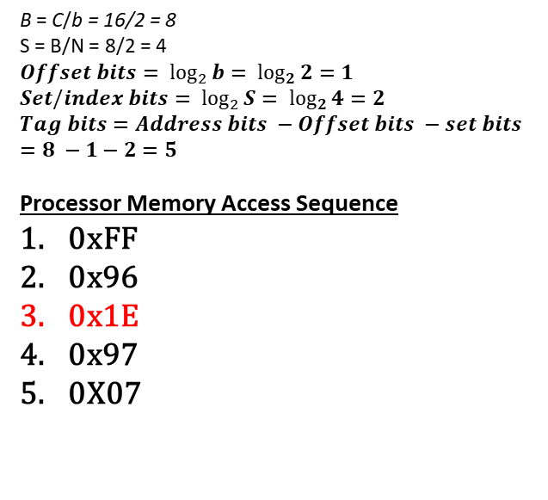
Example 02
Tag Bits Set bits Offset bits
Convert to
binary
0x1E
0001 1110
00 | 00
01 | 01
02 | 02
03 | 03
04 | 04
05 | 05
06 | 06
07 | 07
08 | 08
…….
FD | FD
FE | FE
FF | FF
b = 2B
C = 16B
N = 2 (2-way associative)
Addresses are 8 bits
Sets | V bit | LRU bit | Tags | 0 | 1
00 | 0
 | 0
01 | 0
 | 0
10 | 0
 | 0
11 | 1 | 1 | 11111 | FE | FF
 | 1 | 0 | 10010 | 96 | 97
Sets | V bit | LRU bit | Tags | 0 | 1
00 | 0
 | 0
01 | 0
 | 0
10 | 0
 | 0
11 | 1 | 0 | 00011 | 1E | 1F
 | 1 | 1 | 10010 | 96 | 97
B = C/b = 16/2 = 8
S = B/N = 8/2 = 4
$$Offset bits= \log_{2}{b= \log_{2}{2}}=1$$
$$Set/index bits= \log_{2}{S= \log_{2}{4}}=2$$
$$Tag bits=Address bits −Offset bits −set bits=8 −1−2=5$$
Processor Memory Access Sequence
0xFF
0x96
0x1E
0x97
0X07
Cache
Memory
Cache Miss = 3 Cache Hit = 0

Slide 32
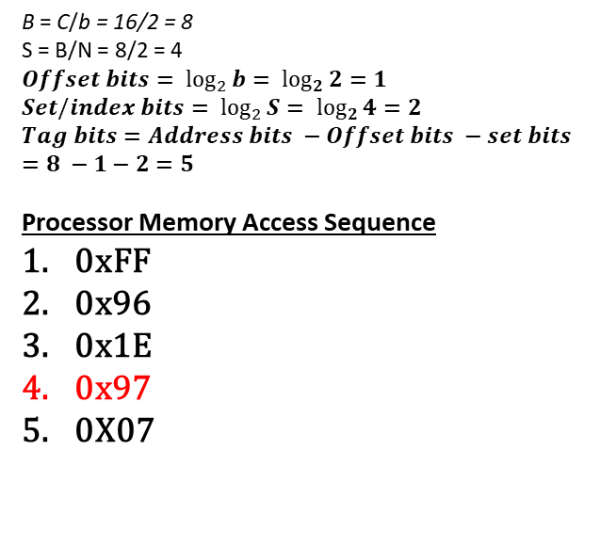
Example 02
Tag Bits Set bits Offset bits
Convert to
binary
0x97
1001 0111
00 | 00
01 | 01
02 | 02
03 | 03
04 | 04
05 | 05
06 | 06
07 | 07
08 | 08
…….
FD | FD
FE | FE
FF | FF
b = 2B
C = 16B
N = 2 (2-way associative)
Addresses are 8 bits
Sets | V bit | LRU bit | Tags | 0 | 1
00 | 0
 | 0
01 | 0
 | 0
10 | 0
 | 0
11 | 1 | 1 | 00011 | 1E | 1F
 | 1 | 0 | 10010 | 96 | 97
Sets | V bit | LRU bit | Tags | 0 | 1
00 | 0
 | 0
01 | 0
 | 0
10 | 0
 | 0
11 | 1 | 0 | 00011 | 1E | 1F
 | 1 | 1 | 10010 | 96 | 97
B = C/b = 16/2 = 8
S = B/N = 8/2 = 4
$$Offset bits= \log_{2}{b= \log_{2}{2}}=1$$
$$Set/index bits= \log_{2}{S= \log_{2}{4}}=2$$
$$Tag bits=Address bits −Offset bits −set bits=8 −1−2=5$$
Processor Memory Access Sequence
0xFF
0x96
0x1E
0x97
0X07
Cache
Memory
Cache Miss = 3 Cache Hit = 1

Slide 33
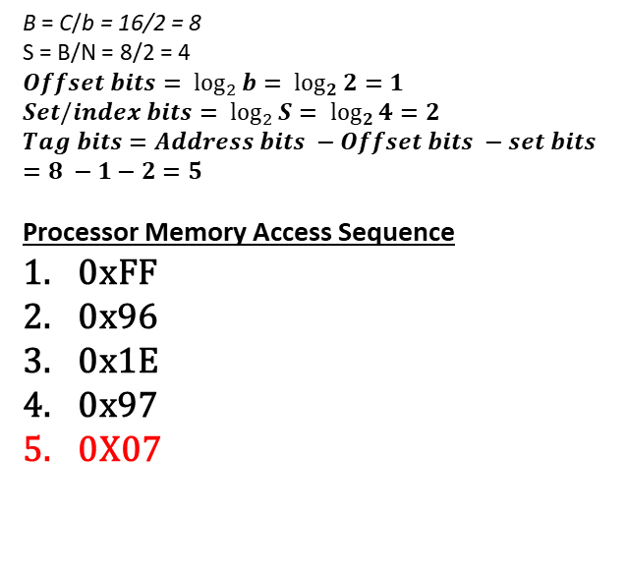
Example 02
Tag Bits Set bits Offset bits
Convert to
binary
0x07
0000 0111
00 | 00
01 | 01
02 | 02
03 | 03
04 | 04
05 | 05
06 | 06
07 | 07
08 | 08
…….
FD | FD
FE | FE
FF | FF
b = 2B
C = 16B
N = 2 (2-way associative)
Addresses are 8 bits
Sets | V bit | LRU bit | Tags | 0 | 1
00 | 0
 | 0
01 | 0
 | 0
10 | 0
 | 0
11 | 1 | 1 | 00011 | 1E | 1F
 | 1 | 0 | 10010 | 96 | 97
Sets | V bit | LRU bit | Tags | 0 | 1
00 | 0
 | 0
01 | 0
 | 0
10 | 0
 | 0
11 | 1 | 0 | 00000 | 06 | 07
 | 1 | 1 | 10010 | 96 | 97
B = C/b = 16/2 = 8
S = B/N = 8/2 = 4
$$Offset bits= \log_{2}{b= \log_{2}{2}}=1$$
$$Set/index bits= \log_{2}{S= \log_{2}{4}}=2$$
$$Tag bits=Address bits −Offset bits −set bits=8 −1−2=5$$
Processor Memory Access Sequence
0xFF
0x96
0x1E
0x97
0X07
Cache
Memory
Cache Miss = 4 Cache Hit = 1

Slide 34
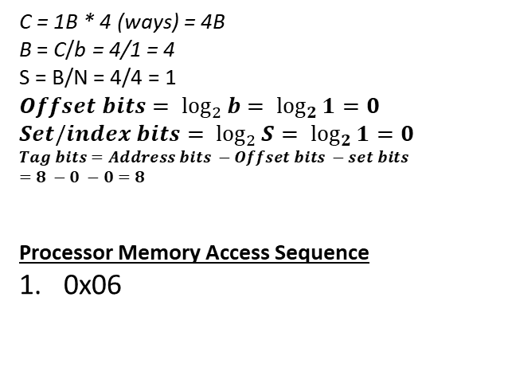
Example 03
Tag Bits Set bits Offset bits
Convert to
binary
0x06
0000 0110
00 | 00
01 | 01
02 | 02
03 | 03
04 | 04
05 | 05
06 | 06
07 | 07
08 | 08
……. | …….
FD | FD
FE | FE
FF | FF
b = 1B
Full Associative Cache
Single set with 4-ways
Address is 8bits
Set | V bit | LRU bit | Tags | Data
 | 1 | 00 | 0000 0110 | 06
 | 0
 | 0
 | 0
C = 1B * 4 (ways) = 4B
B = C/b = 4/1 = 4
S = B/N = 4/4 = 1
$$Offset bits= \log_{2}{b= \log_{2}{1}}=0$$
$$Set/index bits= \log_{2}{S= \log_{2}{1}}=0$$
$$Tag bits=Address bits −Offset bits −set bits$$
$$=8 −0 −0=8$$
Processor Memory Access Sequence
0x06
Cache
Memory
Cache Miss = 1 Cache Hit = 0

Slide 35
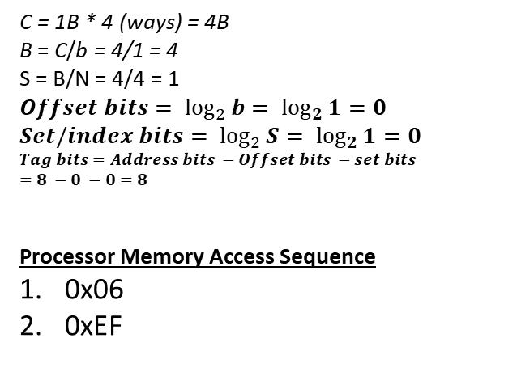
Example 03
Tag Bits Set bits Offset bits
Convert to
binary
0xEF
1110 1111
00 | 00
01 | 01
02 | 02
03 | 03
04 | 04
05 | 05
06 | 06
07 | 07
08 | 08
……. | …….
FD | FD
FE | FE
FF | FF
b = 1B
Full Associative Cache
Single set with 4-ways
Address is 8bits
Set | V bit | LRU bit | Tags | Data
 | 1 | 01 | 0000 0110 | 06
 | 1 | 00 | 1110 1111 | EF
 | 0
 | 0
C = 1B * 4 (ways) = 4B
B = C/b = 4/1 = 4
S = B/N = 4/4 = 1
$$Offset bits= \log_{2}{b= \log_{2}{1}}=0$$
$$Set/index bits= \log_{2}{S= \log_{2}{1}}=0$$
$$Tag bits=Address bits −Offset bits −set bits$$
$$=8 −0 −0=8$$
Processor Memory Access Sequence
0x06
0xEF
Cache
Memory
Cache Miss = 2 Cache Hit = 0

Slide 36
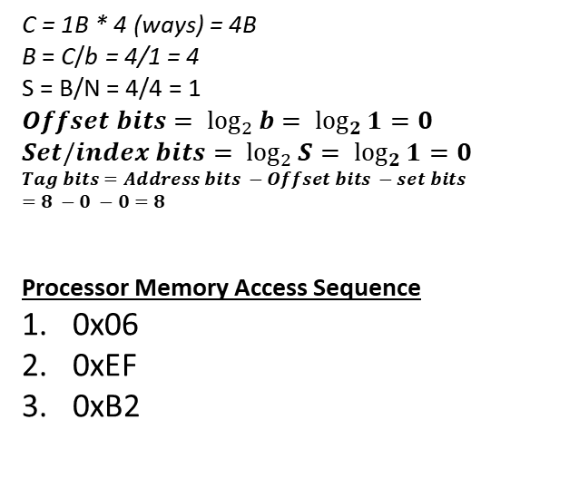
Example 03
Tag Bits Set bits Offset bits
Convert to
binary
0xB2
1011 0010
00 | 00
01 | 01
02 | 02
03 | 03
04 | 04
05 | 05
06 | 06
07 | 07
08 | 08
……. | …….
FD | FD
FE | FE
FF | FF
b = 1B
Full Associative Cache
Single set with 4-ways
Address is 8bits
Set | V bit | LRU bit | Tags | Data
 | 1 | 10 | 0000 0110 | 06
 | 1 | 01 | 1110 1111 | EF
 | 1 | 00 | 1011 0010 | B2
 | 0
C = 1B * 4 (ways) = 4B
B = C/b = 4/1 = 4
S = B/N = 4/4 = 1
$$Offset bits= \log_{2}{b= \log_{2}{1}}=0$$
$$Set/index bits= \log_{2}{S= \log_{2}{1}}=0$$
$$Tag bits=Address bits −Offset bits −set bits$$
$$=8 −0 −0=8$$
Processor Memory Access Sequence
0x06
0xEF
0xB2
Cache
Memory
Cache Miss = 3 Cache Hit = 0

Slide 37
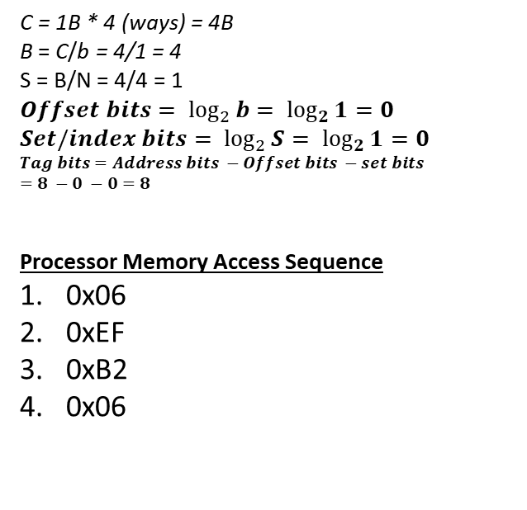
Example 03
Tag Bits Set bits Offset bits
Convert to
binary
0x06
0000 0110
00 | 00
01 | 01
02 | 02
03 | 03
04 | 04
05 | 05
06 | 06
07 | 07
08 | 08
……. | …….
FD | FD
FE | FE
FF | FF
b = 1B
Full Associative Cache
Single set with 4-ways
Address is 8bits
Set | V bit | LRU bit | Tags | Data
 | 1 | 00 | 0000 0110 | 06
 | 1 | 10 | 1110 1111 | EF
 | 1 | 01 | 1011 0010 | B2
 | 0
C = 1B * 4 (ways) = 4B
B = C/b = 4/1 = 4
S = B/N = 4/4 = 1
$$Offset bits= \log_{2}{b= \log_{2}{1}}=0$$
$$Set/index bits= \log_{2}{S= \log_{2}{1}}=0$$
$$Tag bits=Address bits −Offset bits −set bits$$
$$=8 −0 −0=8$$
Processor Memory Access Sequence
0x06
0xEF
0xB2
0x06
Cache
Memory
Respective tag found so it’s a cache hit
Cache Miss = 3 Cache Hit = 1

Slide 38
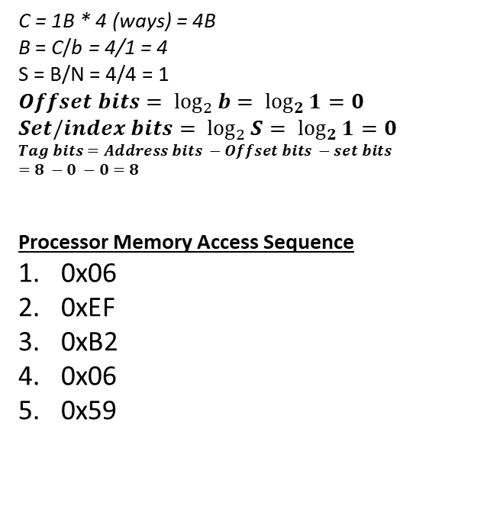
Example 03
Tag Bits Set bits Offset bits
Convert to
binary
0x59
0101 1001
00 | 00
01 | 01
02 | 02
03 | 03
04 | 04
05 | 05
06 | 06
07 | 07
08 | 08
……. | …….
FD | FD
FE | FE
FF | FF
b = 1B
Full Associative Cache
Single set with 4-ways
Address is 8bits
Set | V bit | LRU bit | Tags | Data
 | 1 | 01 | 0000 0110 | 06
 | 1 | 11 | 1110 1111 | EF
 | 1 | 10 | 1011 0010 | B2
 | 1 | 00 | 0101 1001 | 59
C = 1B * 4 (ways) = 4B
B = C/b = 4/1 = 4
S = B/N = 4/4 = 1
$$Offset bits= \log_{2}{b= \log_{2}{1}}=0$$
$$Set/index bits= \log_{2}{S= \log_{2}{1}}=0$$
$$Tag bits=Address bits −Offset bits −set bits$$
$$=8 −0 −0=8$$
Processor Memory Access Sequence
0x06
0xEF
0xB2
0x06
0x59
Cache
Memory
Cache Miss = 4 Cache Hit = 1

Slide 39
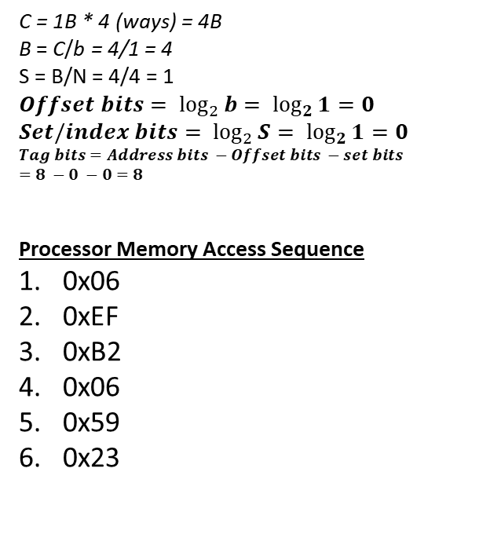
Example 03
Tag Bits Set bits Offset bits
Convert to
binary
0x59
0010 0011
00 | 00
01 | 01
02 | 02
03 | 03
04 | 04
05 | 05
06 | 06
07 | 07
08 | 08
……. | …….
FD | FD
FE | FE
FF | FF
b = 1B
Full Associative Cache
Single set with 4-ways
Address is 8bits
Set | V bit | LRU bit | Tags | Data
 | 1 | 10 | 0000 0110 | 06
 | 1 | 00 | 0010 0011 | 23
 | 1 | 11 | 1011 0010 | B2
 | 1 | 01 | 0101 1001 | 59
C = 1B * 4 (ways) = 4B
B = C/b = 4/1 = 4
S = B/N = 4/4 = 1
$$Offset bits= \log_{2}{b= \log_{2}{1}}=0$$
$$Set/index bits= \log_{2}{S= \log_{2}{1}}=0$$
$$Tag bits=Address bits −Offset bits −set bits$$
$$=8 −0 −0=8$$
Processor Memory Access Sequence
0x06
0xEF
0xB2
0x06
0x59
0x23
Cache
Memory
Cache Miss = 4 Cache Hit = 1

Slide 40
Types of Cache Misses
Compulsory Miss:
The first request to a cache block is called a compulsory miss, because the block must be read from memory regardless of the cache design.
Capacity Miss:
Capacity misses occur when the cache is too small to hold all concurrently used data.
Conflict Miss:
Conflict misses are caused when several addresses map to the same set and evict blocks that are still needed.

Slide 41
Cache Parameters
Increasing cache capacity can reduce conflict and capacity misses, but it does not affect compulsory misses.
Increasing block size could reduce compulsory misses (due to spatial locality). But as block size increases, the number of sets in a fixed-size cache decreases, increasing the probability of conflicts.
An N-way set associative cache reduces conflicts by providing N blocks in each set where data mapping to that set might be found. Each memory address still maps to a specific set, but it can map to any one of the N blocks in the set. However, set associative caches are usually slower and somewhat more expensive to build

Slide 42
Cache Write Policies
Implemented to handle writes
Hit Policy
Two methods to handle writes if the data is already present in the cache.
Write Through
Write Back
Miss Policy
Two methods to handle writes if the data is not present in the cache.
Write Allocate
Write Around

Slide 43
Write Through
Update cache as well as memory
Advantage: - read miss never results in writes to main memory - easy to implement - main memory always has the most current copy of the data (consistent) Disadvantage: - write is slower - every write needs a main memory access
Example: Set bits = 3; Tag bits = 5; Offset bits =0; Address bits = 8
……
0C | 99
…..
A4 | 45
A5 | 27
……
……
0C | 99
…..
A4 | 68
A5 | 27
……
Set | Tag bits | Data
…..
100 | 10100 | 68
…..
Set | Tag bits | Data
…..
100 | 10100 | 45
…..
Processor
MOV [A4], 68 MOV AL, [0C]
Hit
Update both cache and memory

Slide 44
Write Through
Update cache as well as memory
Advantage: - read miss never results in writes to main memory - easy to implement - main memory always has the most current copy of the data (consistent) Disadvantage: - write is slower - every write needs a main memory access
Example: Set bits = 3; Tag bits = 5; Offset bits =0; Address bits = 8
……
A2 | 45
A3 | FF
A4 | 73
A5 | 27
……
……
0C | 99
…..
A4 | 68
A5 | 27
……
Set | Tag bits | Data
…..
100 | 10100 | 45
…..
Set | Tag bits | Data
…..
100 | 10100 | 68
…..
Set | Tag bits | Data
…..
100 | 00001 | 99
…..
Processor
MOV [A4], 68 MOV AL, [0C]
Miss

Slide 45
Write Back
Update cache only. Update memory only in case of data eviction and a dirty bit is used. This status bit indicates whether the block is dirty (modified while in the cache) or clean (not modified). If it is clean the block is not written on a miss.
Advantage: - writes occur at the speed of the cache memory - multiple writes within a block require only one write to main memory - as a result uses less memory bandwidth Disadvantage: - harder to implement - main memory is not always consistent with cache - reads that result in replacement may cause writes of dirty blocks to main memory
……
0C | 99
…..
A4 | 45
A5 | 27
……
Set | Dirty bit | Tag bits | Data
…..
100 | 1 | 10100 | 68
…..
Set | Dirty bit | Tag bits | Data
…..
100 | 0 | 10100 | 45
…..
Processor
MOV [A4], 68 MOV AL, [0C]
Hit
Update only cache and set dirty bit to 1

Slide 46
Write Back
Update cache only. Update memory only in case of data eviction and a dirty bit is used. This status bit indicates whether the block is dirty (modified while in the cache) or clean (not modified). If it is clean the block is not written on a miss.
Advantage: - writes occur at the speed of the cache memory - multiple writes within a block require only one write to main memory - as a result uses less memory bandwidth Disadvantage: - harder to implement - main memory is not always consistent with cache - reads that result in replacement may cause writes of dirty blocks to main memory
……
0C | 99
…..
A4 | 45
A5 | 27
……
……
0C | 99
…..
A4 | 68
A5 | 27
……
Set | Dirty bit | Tag bits | Data
…..
100 | 0 | 00001 | 99
…..
Set | Dirty bit | Tag bits | Data
…..
100 | 1 | 10100 | 68
…..
Processor
MOV [A4], 68 MOV AL, [0C]
Update the memory
Miss
Place [0C] in cache
As dirty bit is 1, before eviction update the memory

Slide 47
Write Allocate
Bring data in the cache
Example: Set bits = 3; Tag bits = 5; Offset bits =0; Address bits = 8
……
0C | 99
…..
A4 | 45
A5 | 27
……
……
0C | 68
…..
A4 | 45
A5 | 27
……
Set | Tag bits | Data
…..
100 | 00001 | 68
…..
Set | Tag bits | Data
…..
100 | 10100 | 45
…..
Processor
MOV [0C], 68
Miss
Bring data in cache

Slide 48
Write Around
Also called Write No-Allocate
Update data block in memory
Example: Set bits = 3; Tag bits = 5; Offset bits =0; Address bits = 8
……
0C | 99
…..
A4 | 45
A5 | 27
……
……
0C | 68
…..
A4 | 45
A5 | 27
……
Set | Tag bits | Data
…..
100 | 10100 | 45
…..
Processor
MOV [0C], 68
Miss
Update memory
Don’t bring data in cache

